Slide 1
Automated bicycle
Edwin Odeimi #201601044
Charbel El Khoury #201603822
Ahmad Bitar #201507093
Advisor: Dr. Zahi Nakad

Slide 2
Outline
Main Motor Installation
Batteries and Electronics Housing
Gear Shifting
Gear Detection
Dashboard
Speed and Cadence Sensors
PID Control System for Cruise Control
Video Demo

Slide 3
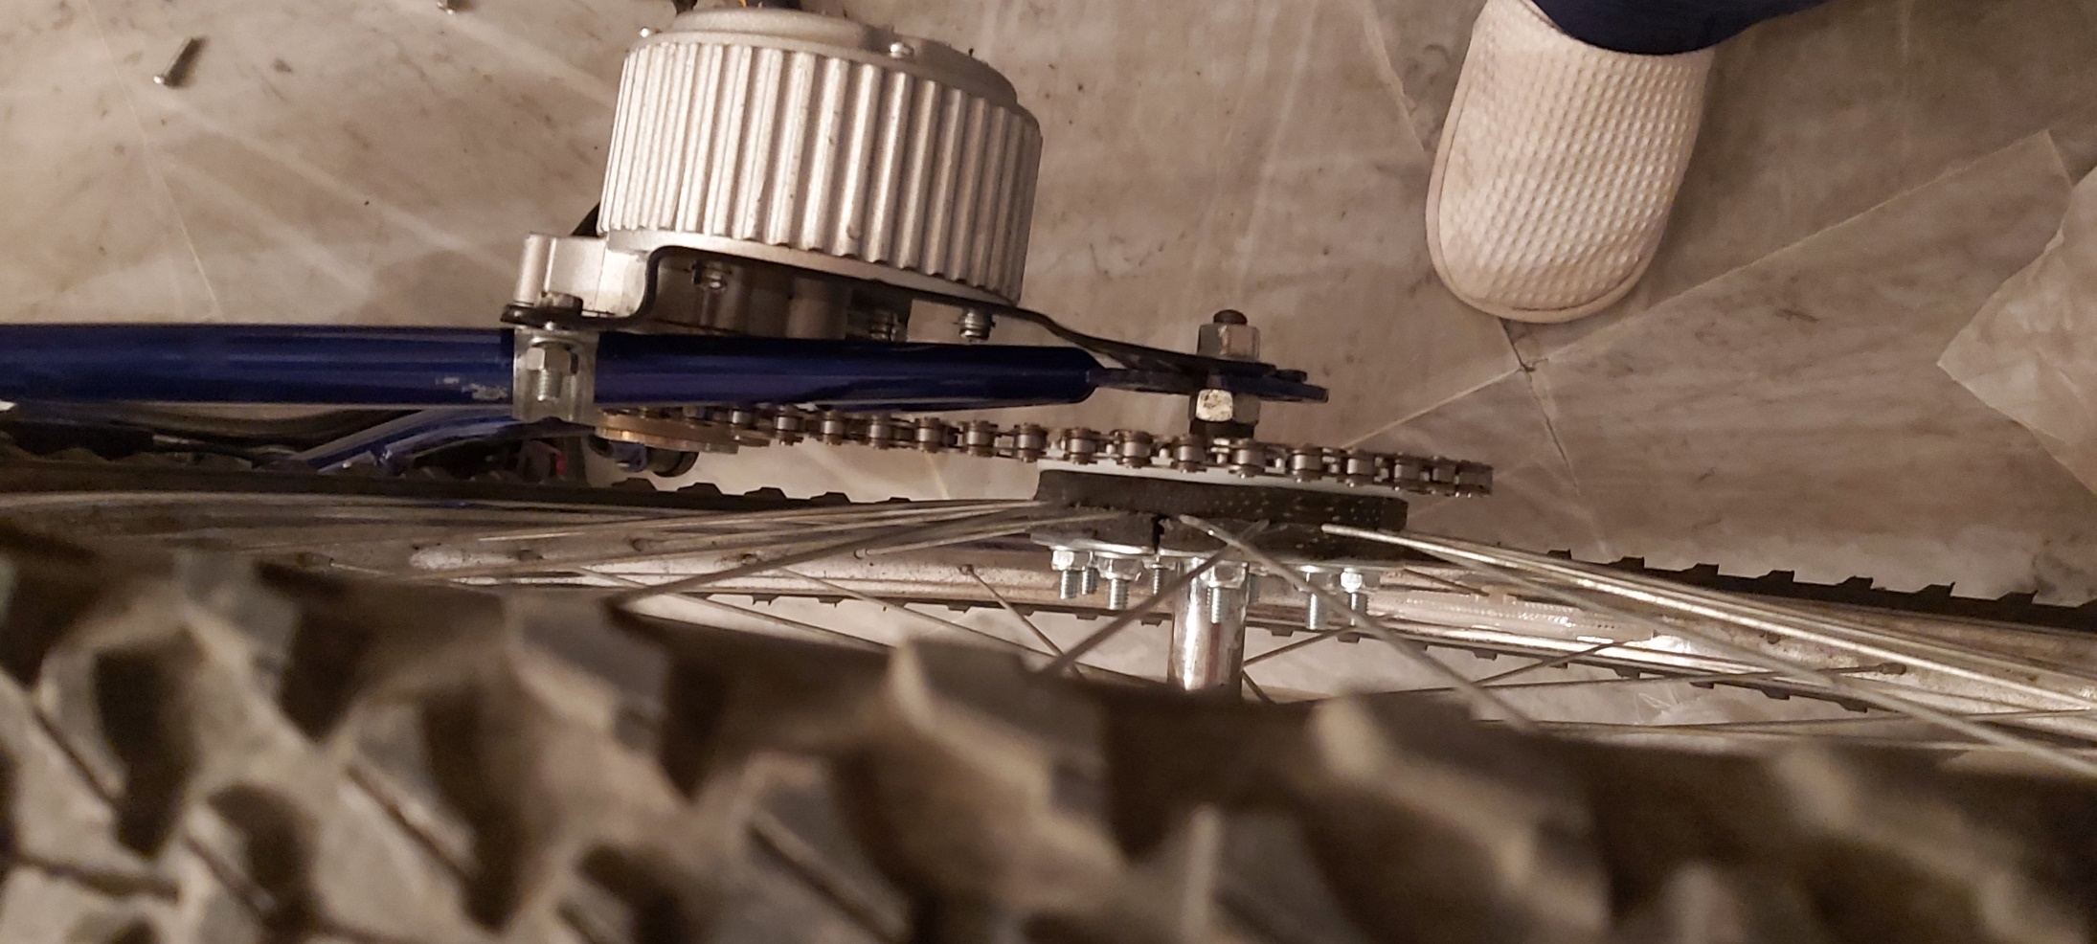
Main Motor Installation - Mounted
Motor Mounted – Misaligned and Touching The Chassis

Slide 4
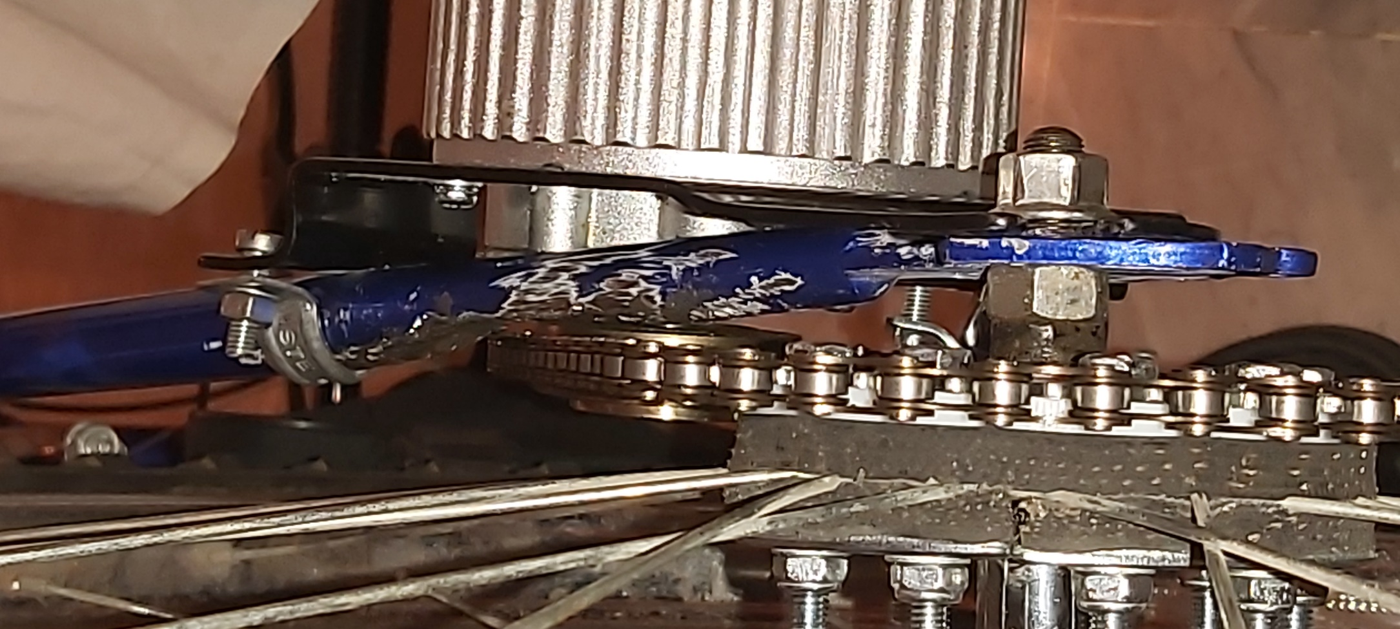
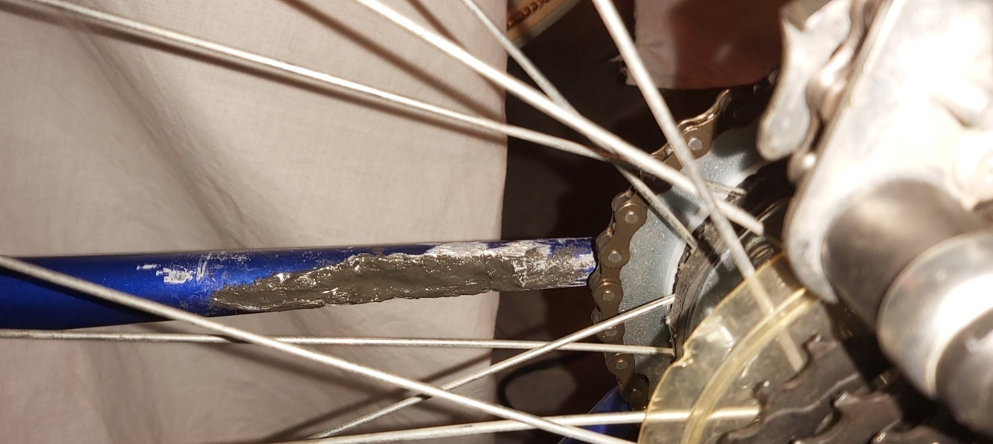
Main Motor Installation – Solution (1)
Chassis Cut to Free the Chain (2)
Chassis Cut to Free the Chain (1)

Slide 5
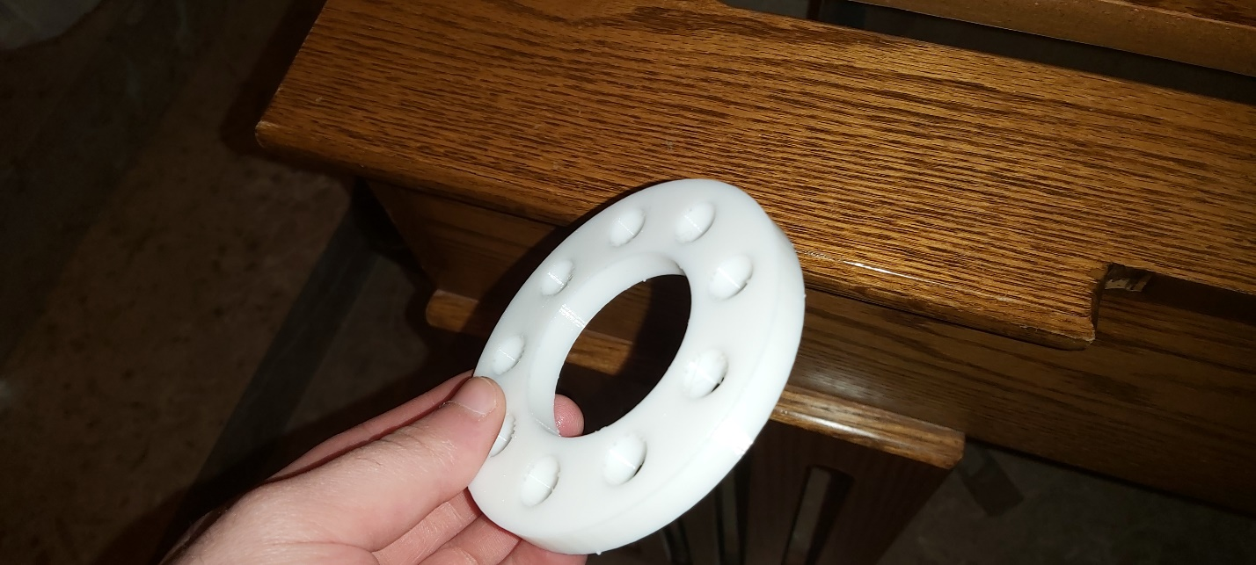
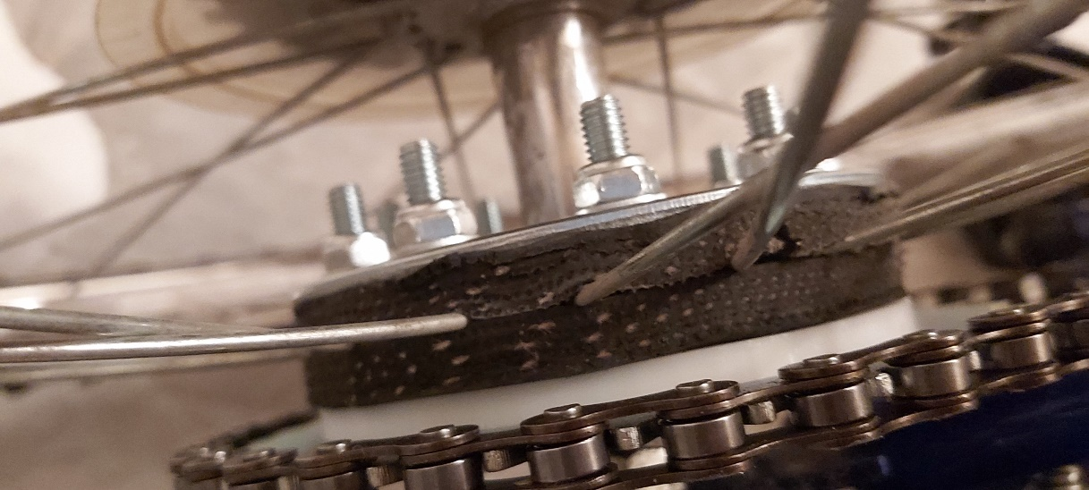
Main Motor Installation – Solution (2)
Rim Gear Offset for Gear Alignment (2)
Rim Gear Offset for Gear Alignment (1)

Slide 6
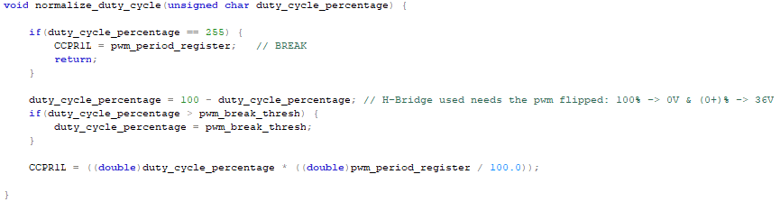
Main Motor Installation – Code
Motor PWM Duty Cycle Normalization for Driver Control

Slide 7
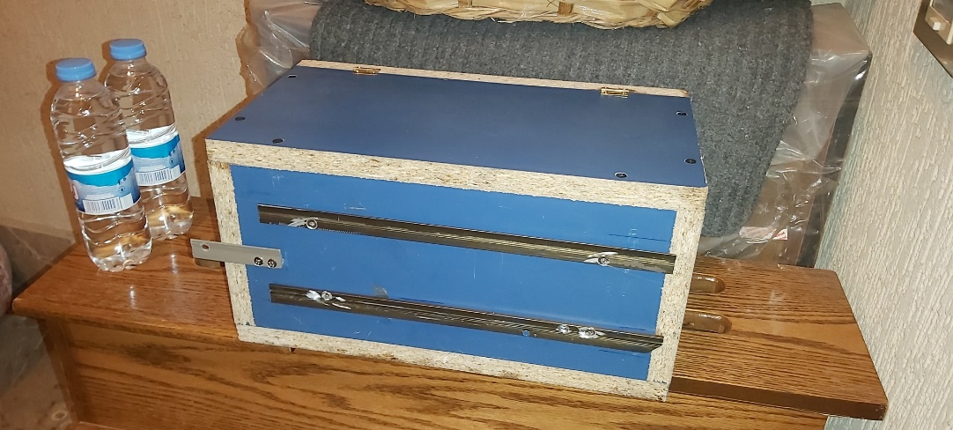
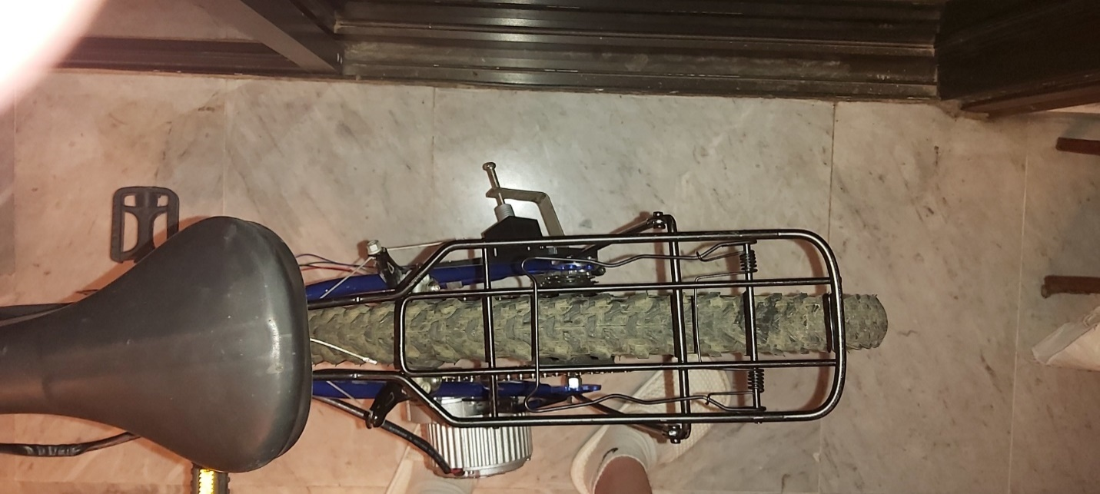
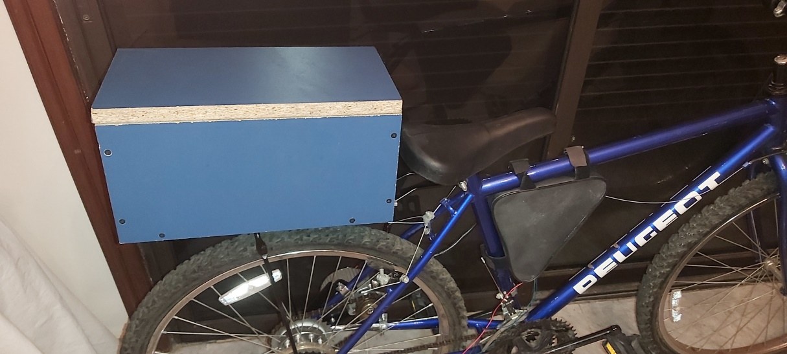
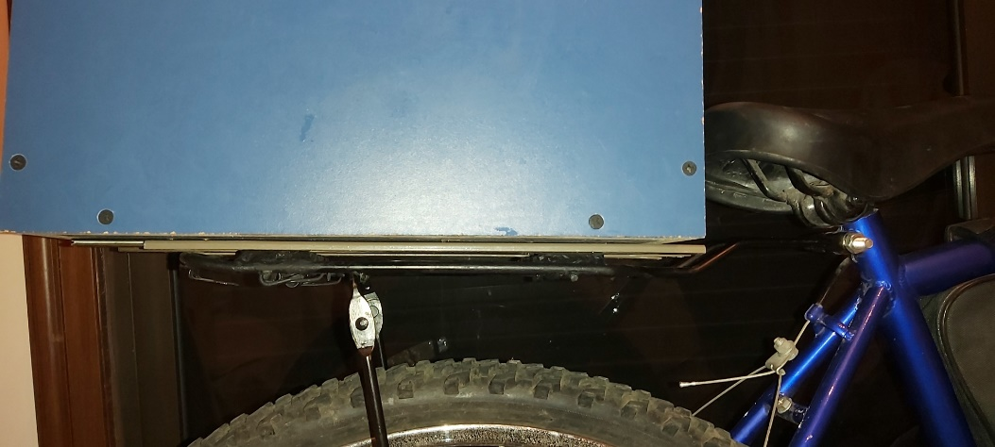
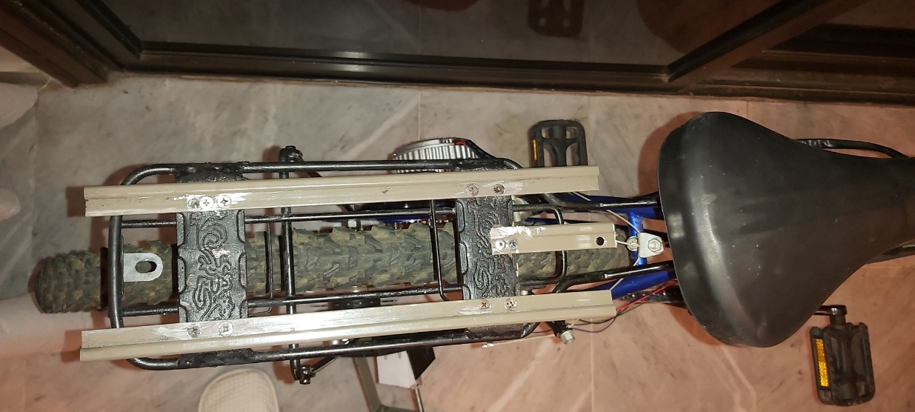
Batteries and Electronics Housing
Bicycle Rack
Housing Sliding Modification
Bicycle Rack Housing Mounted
Bicycle Rack Modified
Housing Sliding Modification Close-up

Slide 8
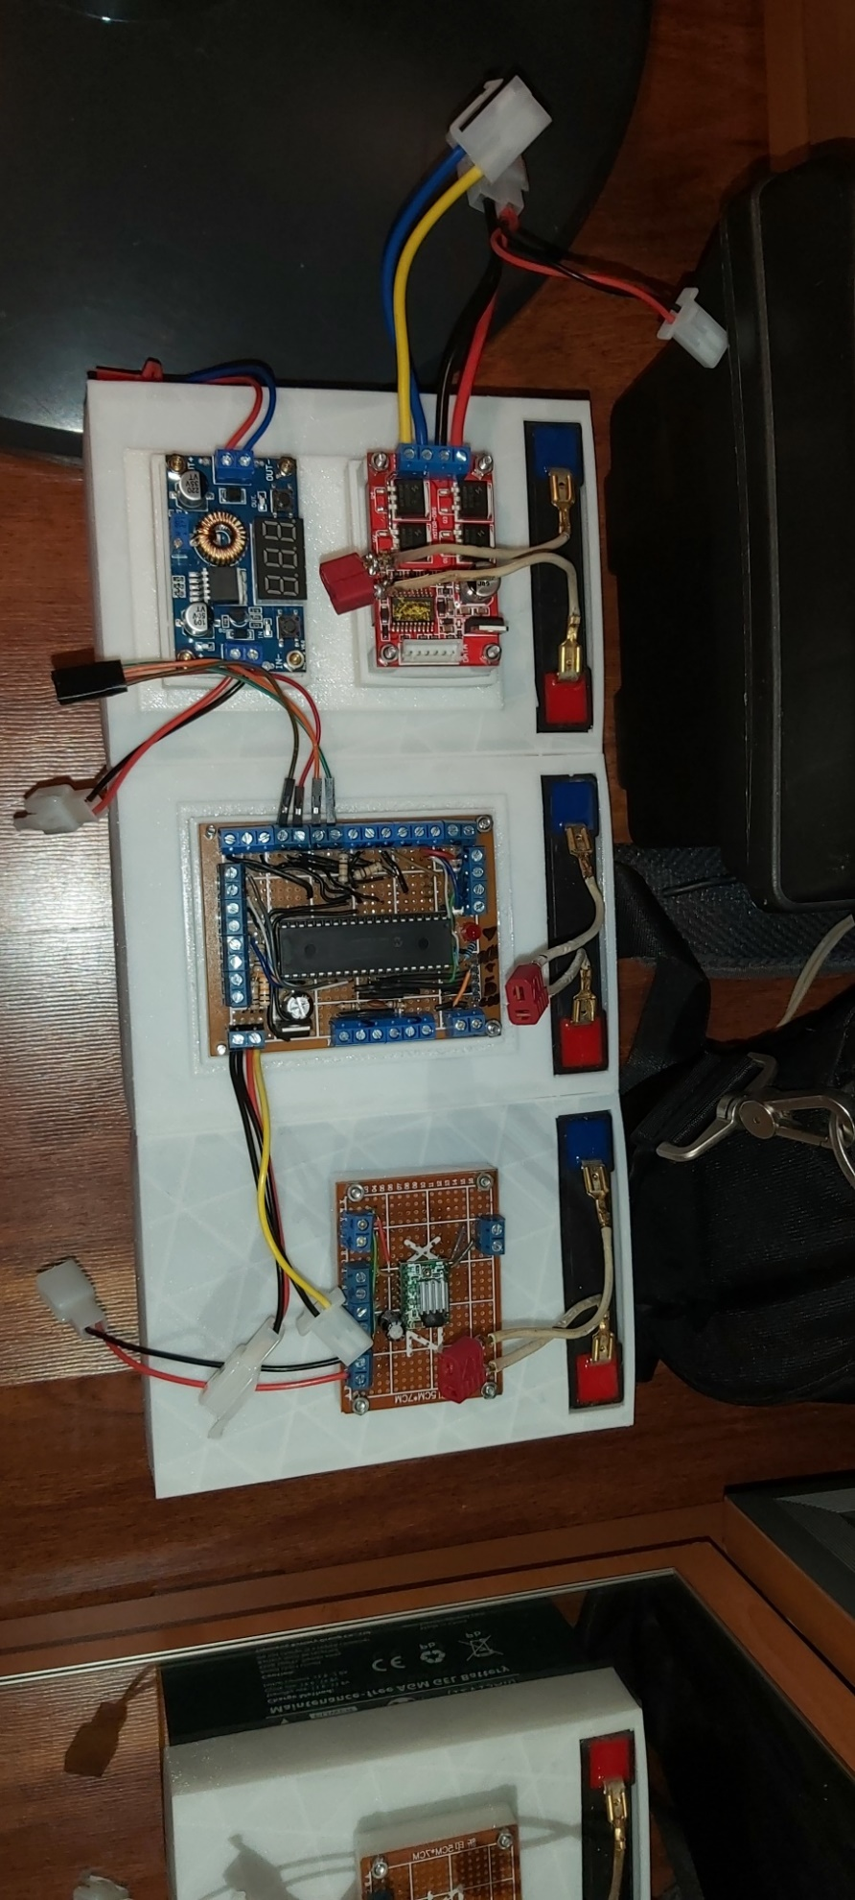
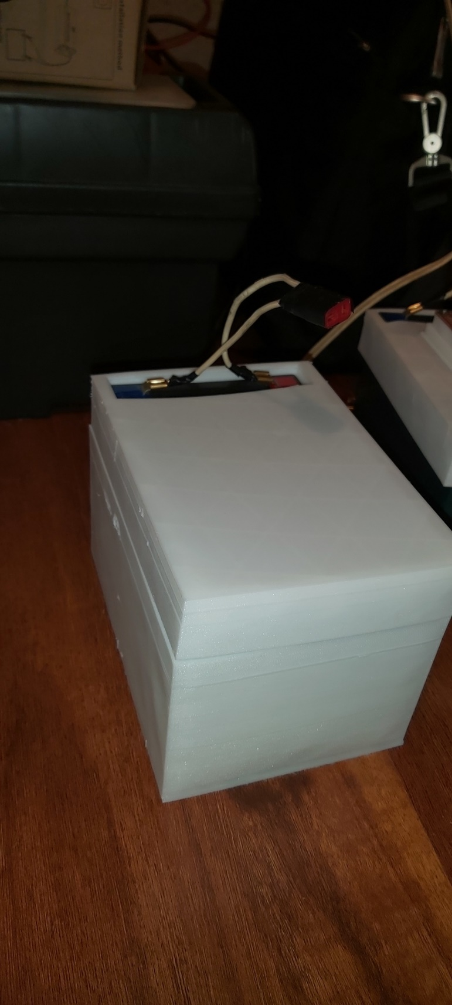
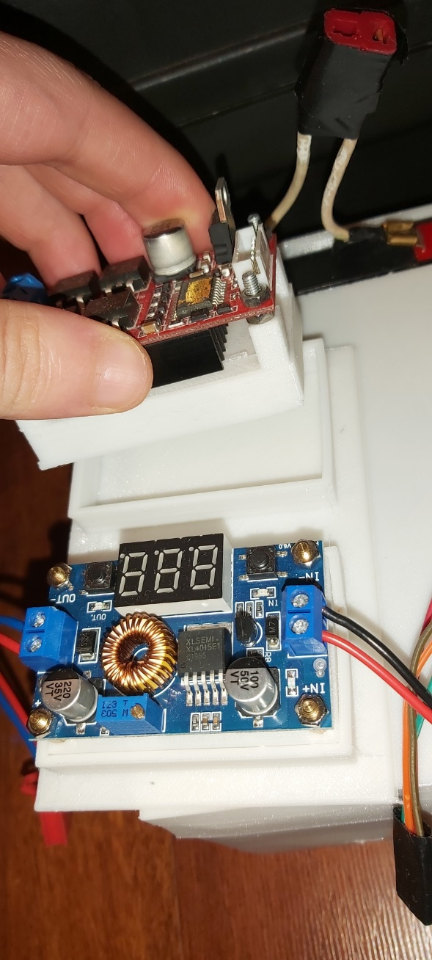
Batteries and Electronics Housing – Electronics External Protection
Batteries and Electronics Shaking Protection
Electronics TPU Press-Fit Design
Battery TPU Layer of Protection

Slide 9
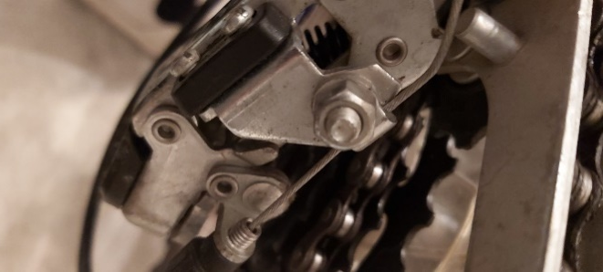
Gear Shifting
Original Gear Shifting Mechanism

Slide 10
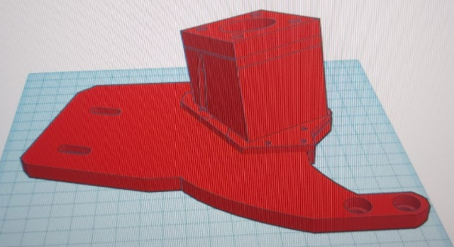
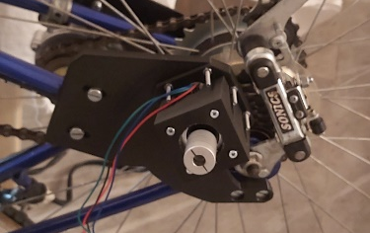
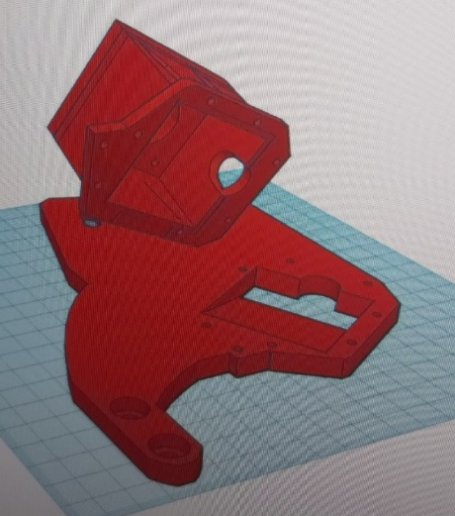
Electronic Gear Shifting – Design (1)
Electronic Gear Shifting Mechanism Mount using TinkerCad (1)
Electronic Gear Shifting Mechanism Mount
Electronic Gear Shifting Mechanism Mount using TinkerCad (2)

Slide 11
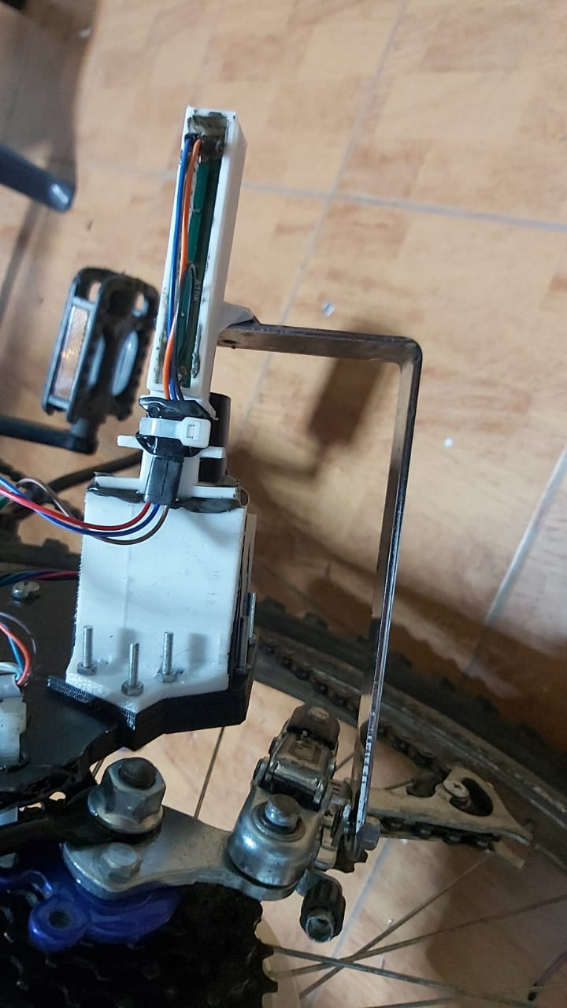
Electronic Gear Shifting – Design (2)
Electronic Gear Shifting Mechanism – L-Shaped Metal Link Attached to the Derailleur

Slide 12
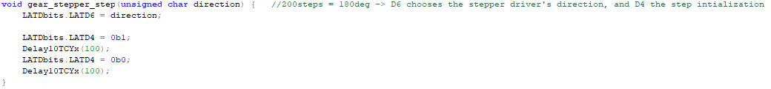
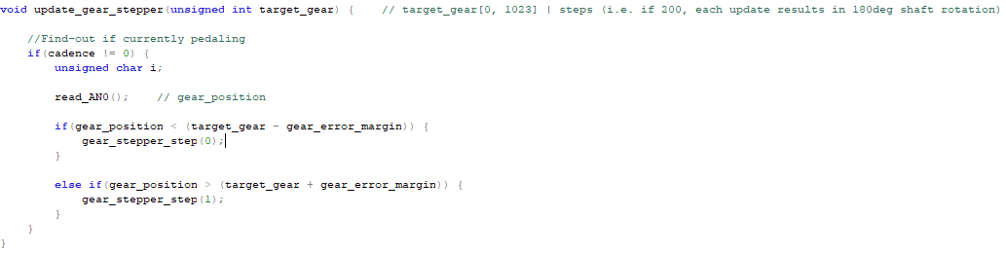
Electronic Gear Shifting – Code (1)
Gear Shifting Stepper Motor Control Signals
Gear Change Given a Target Gear

Slide 13
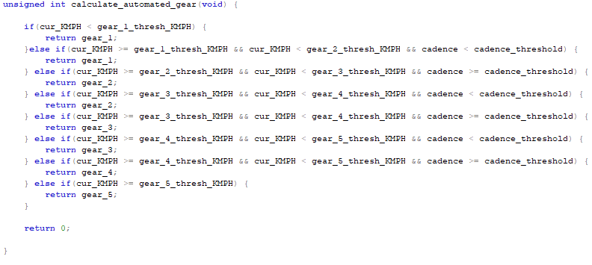
Electronic Gear Shifting – Code (2)
Assistive Automated Gear Shifting Based on Speed and Pedaling State

Slide 14
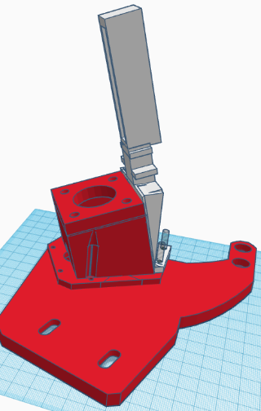
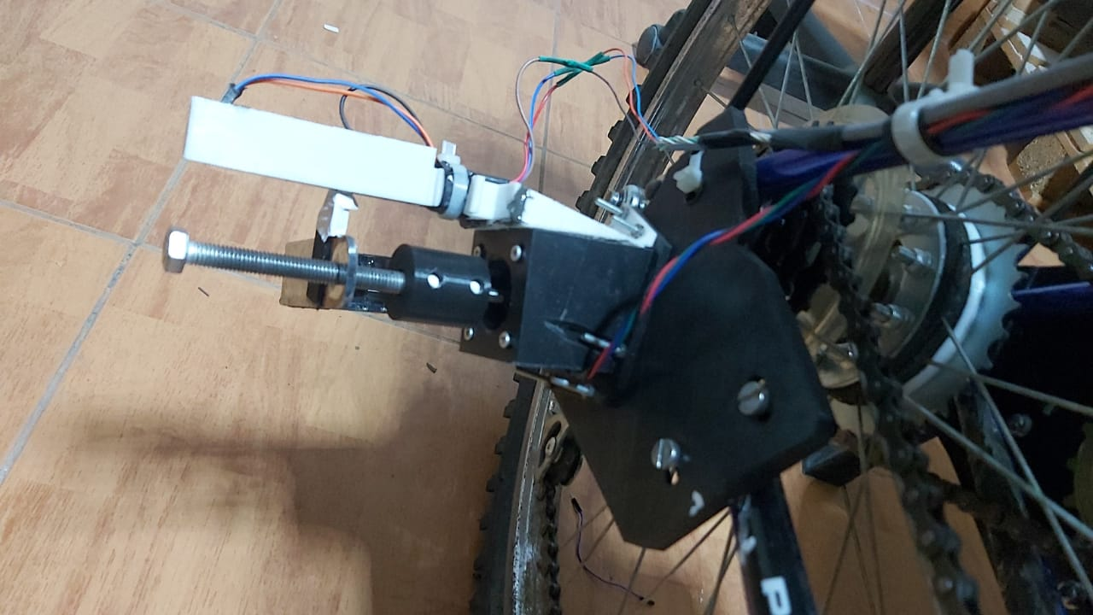
Gear Detection
Gear Detection Potentiometer using TinkerCad
Gear Detection Potentiometer Mounted

Slide 15
Full Gear Shifting Mechanism - Assembled
Gear Shifting and Detection Mechanisms Mounted

Slide 16
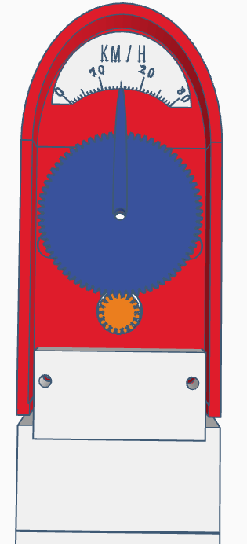
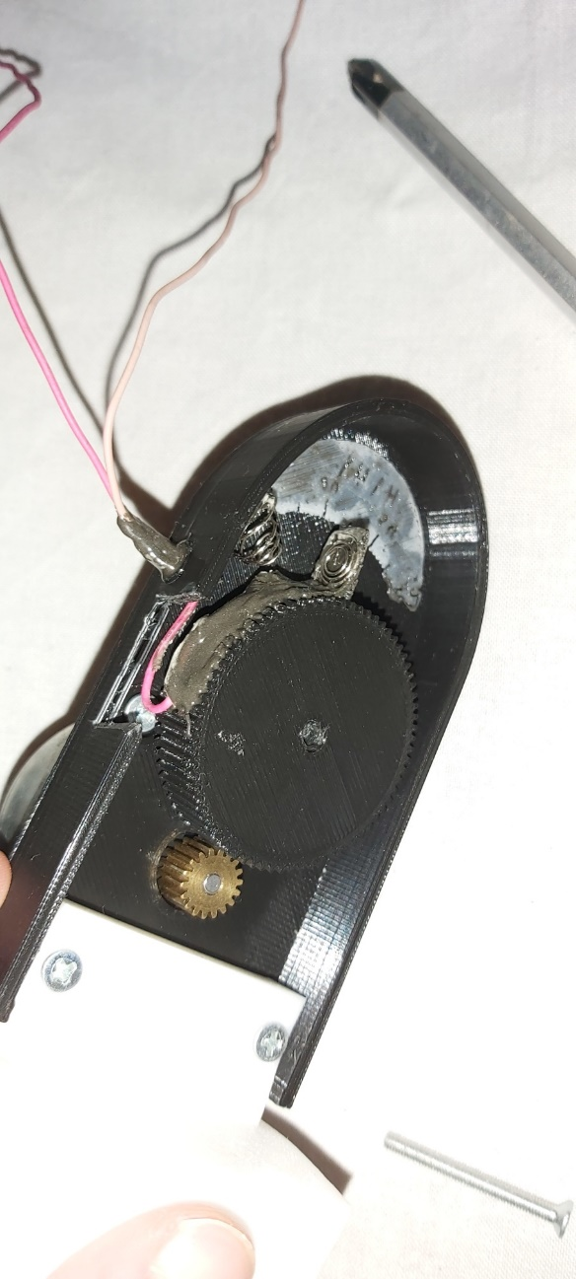
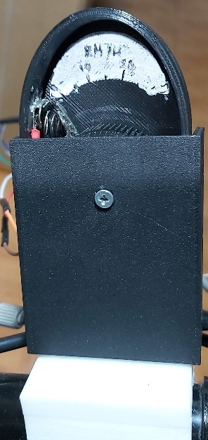
Dashboard – Speedometer Design
Speedometer Design using TinkerCad
Speedometer Design Assembled
Speedometer Design Opened

Slide 17
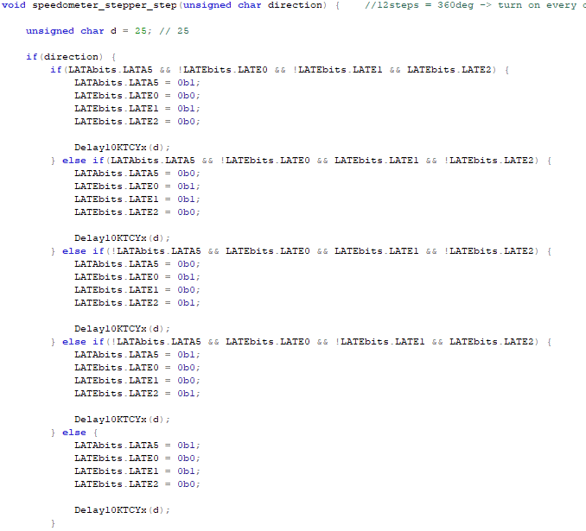
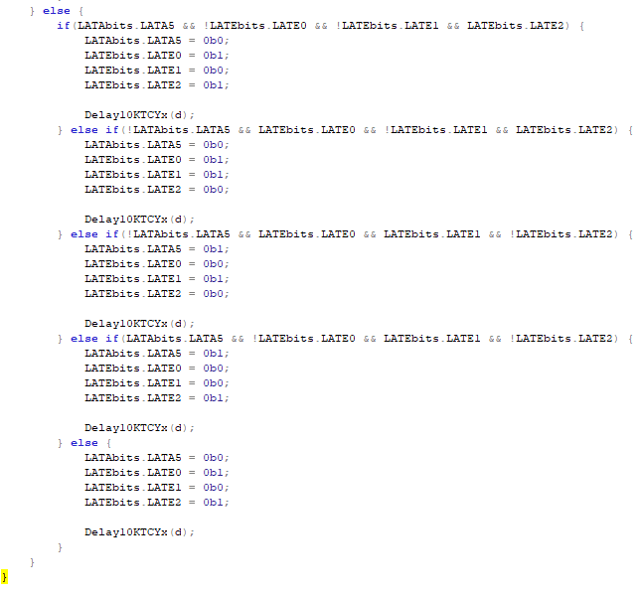
Dashboard – Speedometer Code (1)
Speedometer Stepper Control Signals

Slide 18
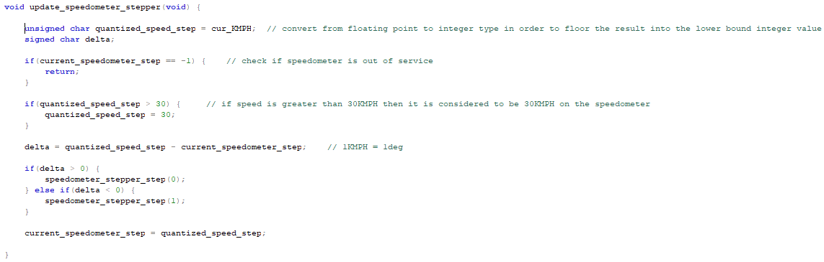
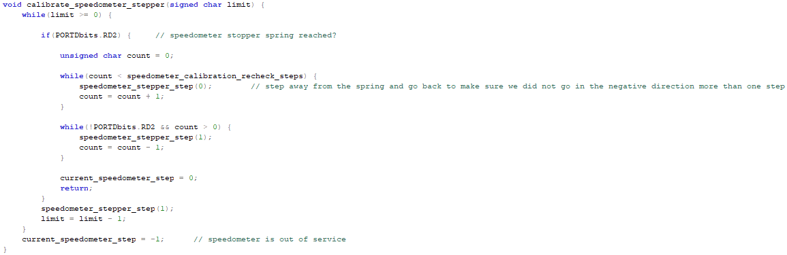
Dashboard – Speedometer Code (2)
Updating Speedometer Position
Calibrate Speedometer when Initializing

Slide 19
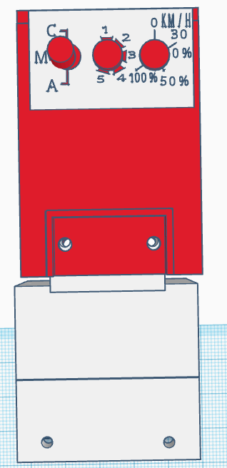
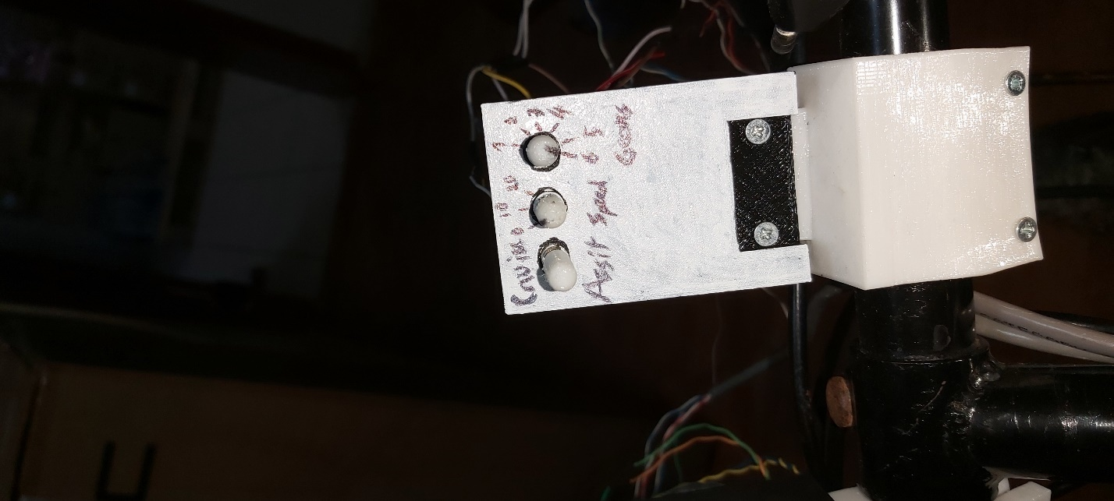
Dashboard – User Input Interface Design
User Input Interface Design using TinkerCad
User Input Interface Design Assembled

Slide 20
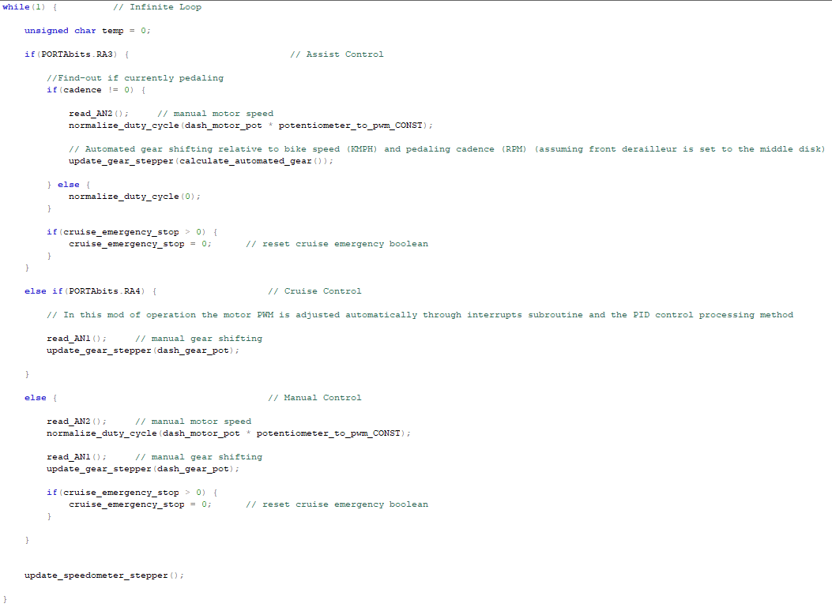
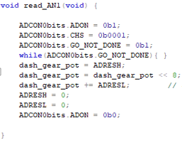
Dashboard – User Input Interface Code
Potentiometers A/D Conversion
Mode of Operation using Dashboard Switch

Slide 21
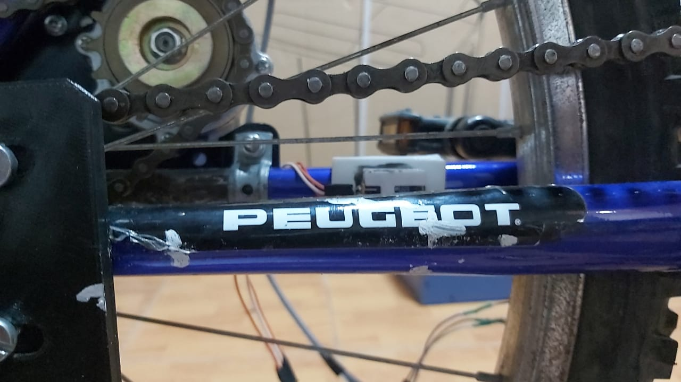
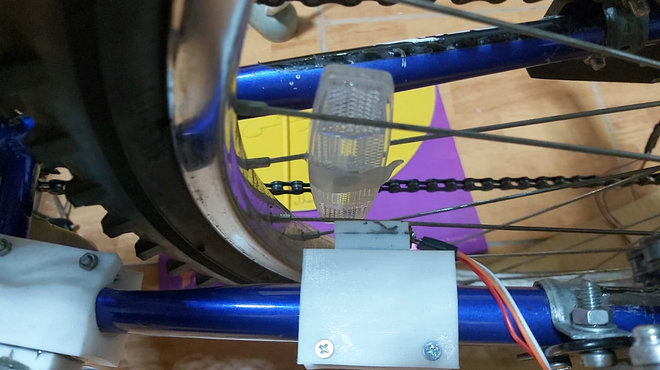
Speed and Cadence - Design
Hall-Effect Sensor Mounted (1)
Hall-Effect Sensor Mounted (2)

Slide 22
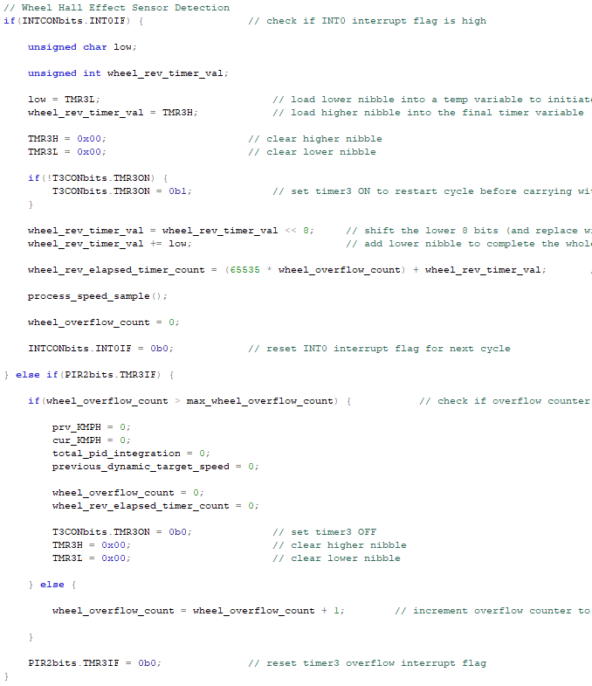
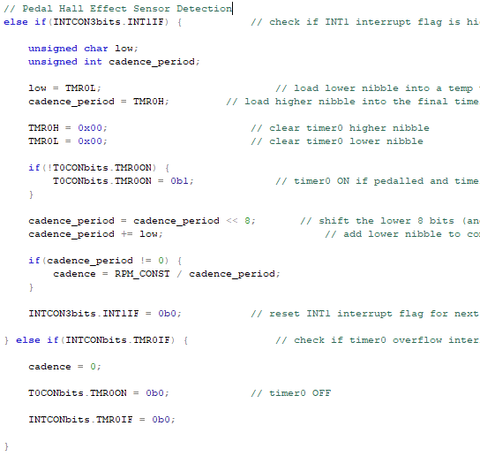
Speed and Cadence – Code (1)
Pedal Hall-Effect Sensor External Interrupt Subroutine and Cadence Calculation
Wheel Hall-Effect Sensor External Interrupt Subroutine

Slide 23
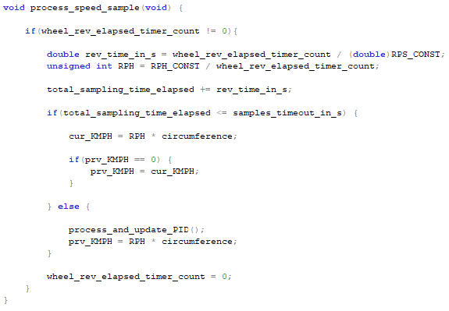
Speed and Cadence – Code (2)
Calculation of System Speed based on Wheel Rotation Period

Slide 24
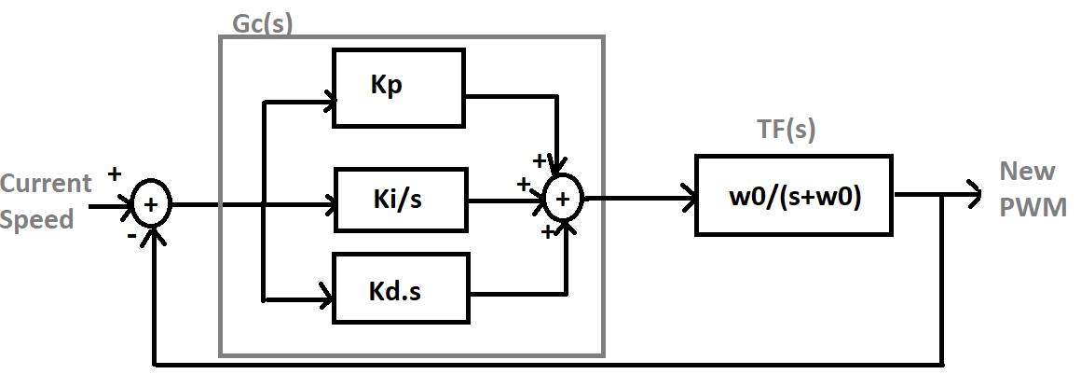
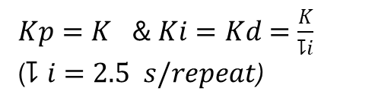
PID Control System for Cruise Control (1)
Full System Block Diagram
$\left.Gc\left(s\right)= \frac{Kd}{s} (s^{2}+\frac{Kp}{Kd} s+ \frac{Ki}{Kd}\right)$ or $Gc\left(s\right)= \frac{K}{2.5} \left(\frac{s^{2}+2.5 s+ 1}{s}\right)$ where
$Kp=K$ & $Ki=Kd=\frac{K}{⥝i}$
($⥝i=2.5 s/repeat$)

Slide 25
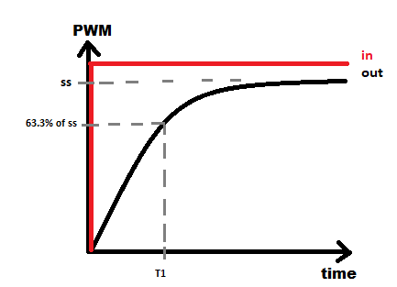
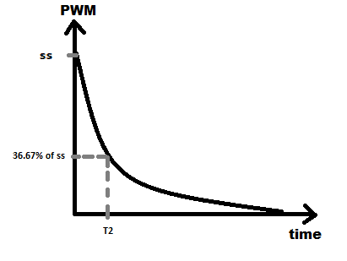
PID Control System for Cruise Control (2)
T₁ = 18 s
T₂ = 23 s

Slide 26
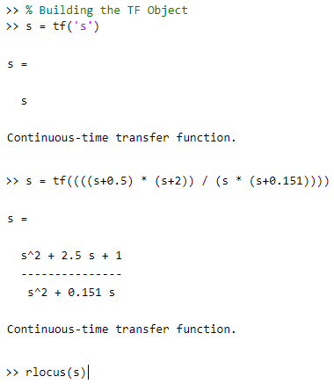
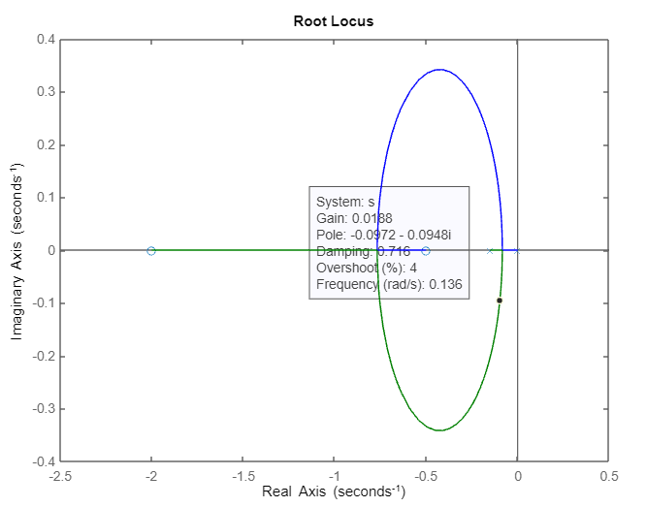
PID Control System for Cruise Control (3)
$CE= K . OLTF\left(s\right) . 1=Kn \frac{\left(s + 0.5\right)\left(s + 2\right)}{s\left(s+0.151\right)}$ where Kn = $0.0604 . K$
MATLAB Code for Root Locus
MATLAB Drawing the Root Locus and Choosing Kn

Slide 27
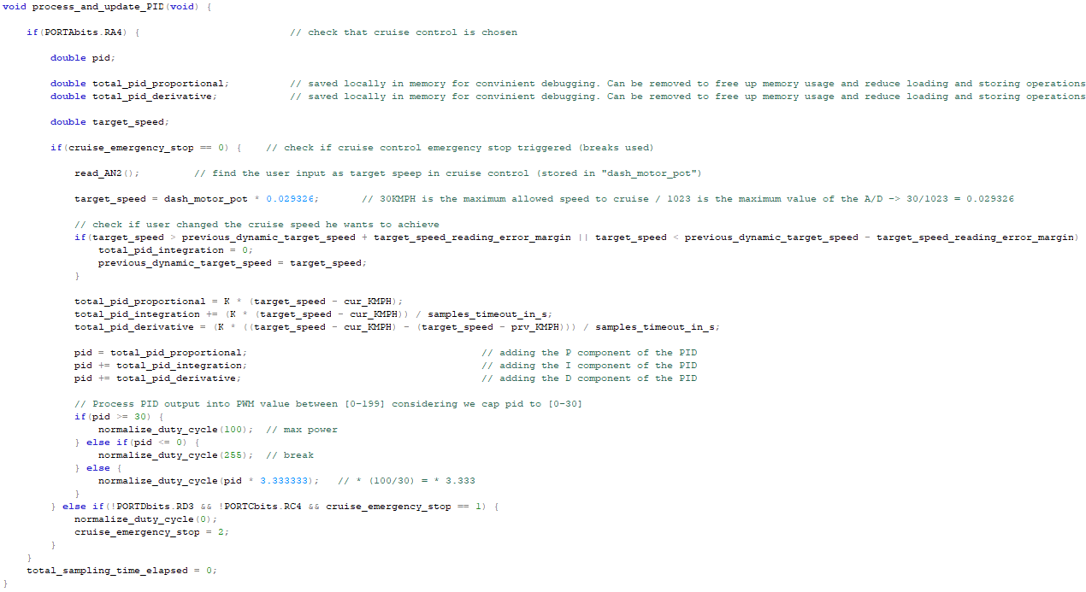
PID Control System for Cruise Control - Code
PID PWM Calculation Code

Slide 28
Video Demo …

Slide 29
Thank you!

